Slide 1
Predicting Mortgage Prepayment using Deep Neural Network

Slide 2
Outline
Introduction
Literature Review
Exploratory Data Analysis
Model
Conclusion
Future Aspects

Slide 3
Introduction
Lending Tree estimates mortgages value of $10.5 trillion (2019)
Mortgage prepayment is behavioral decisions and, historically, it has been difficult to model these behaviors.
Two kinds of mortgage prepayment – Refinance and Turnover
The ability to predict mortgage prepayment is of critical use to financial institutions from an interest rate risk perspective.
We used an LSTM and RNN architecture, and hyper parameter tuning to build models and achieve MAPE value of 8.44%

Slide 4

Literature Review
Kumar, V. 2014. “Feature Selection: A Literature Review.” Smart Computing Review 4 (3) https://www.cc.gatech.edu/~hic/CS7616/Papers/Kumar-Minz-2014.pdf
Peter G. Drembelas, Vibhor V. Khar, (2019) https://cs230.stanford.edu/projects_fall_2019/reports/26259259.pdf
Shlomo Amar, (2020, November) https://b-fine.be/wp-content/uploads/2020/12/Modeling_of_Mortgage_Loan_Prepayment_Risk_with_Machine_Learning.pdf
Yu, Y. 2018. “MSCI Agency Fixed Rate Refinance Prepayment Model.” Research paper, MSCI.
https://www.msci.com/www/research-paper/msci-agency-fixed-rate/01118884978
Zhang, J. 2018a. “Is MBS Ref inance Risk Increasing?” Research paper, MSCI
https://jsf.pm-research.com/content/iijstrfin/24/4/local/complete-issue.pdf

Slide 5

Data
Data for MBA originated across USA between 1990-2021
Weekly performance update as a target variable
Mortgage Bankers Association Refi Index (Bloomberg Terminal)
Data for national economic factors from FRED (Federal Reserve Economic Data)
Economically significant data
11,451 daily observations, each described by roughly 26 feature variables
Correlation was used to choose feature selection

Slide 6
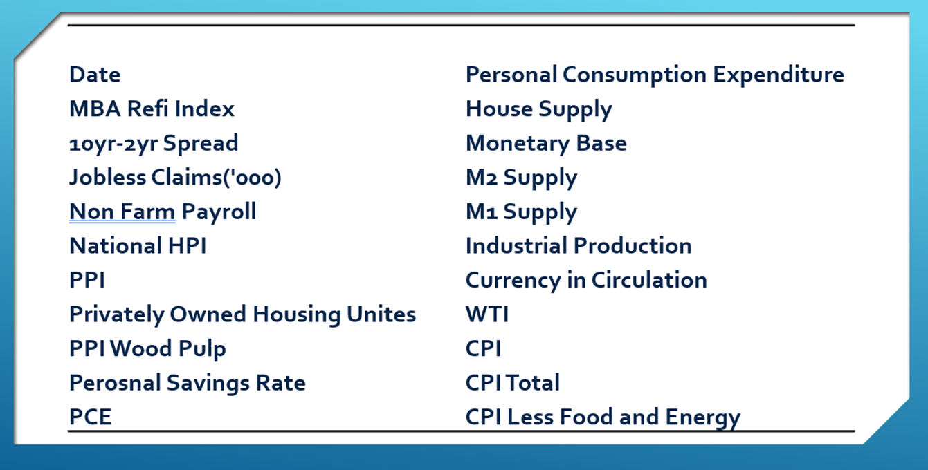
Data

Slide 7
Data
Data Constraints
Data in format needed for models
Weekly, monthly, and quarterly data were extrapolated to daily data points
Missing values removed
Percentage < 0.5%
Split in training and testing(module development)
After cleaning roughly 26 features are remaining

Slide 8

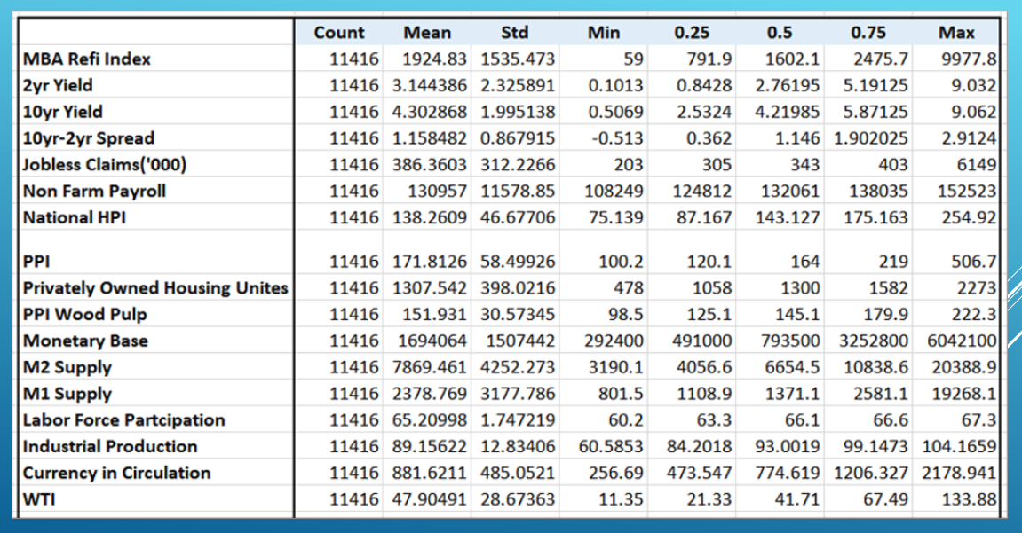
Summary Statistics for Variables Exploratory Data Analysis

Slide 9
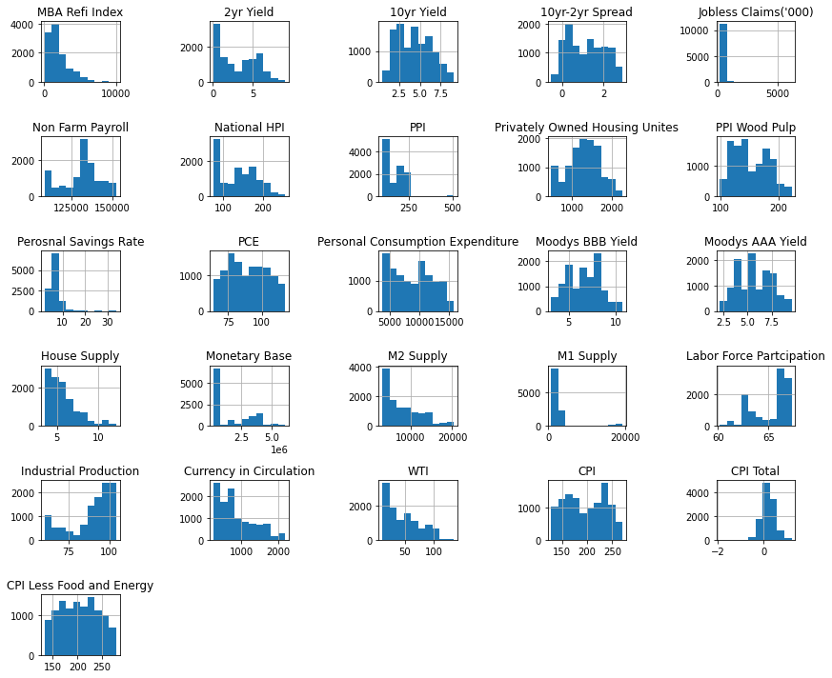
Exploratory Data Analysis

Slide 10

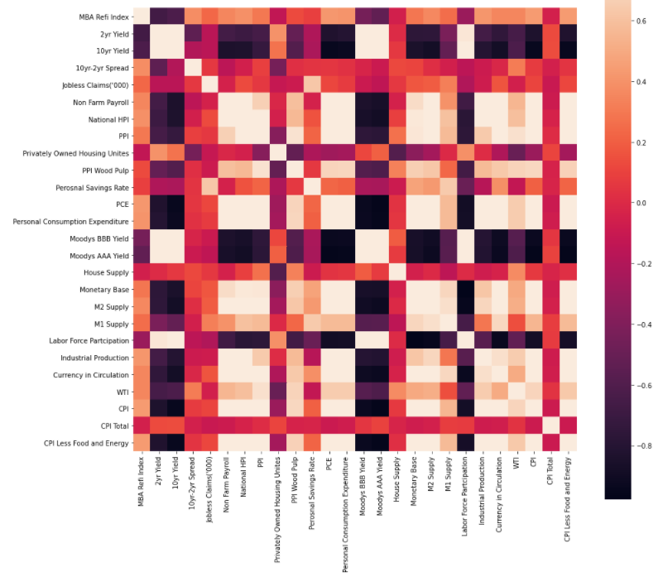
Exploratory Data Analysis Correlation Matrix

Slide 11
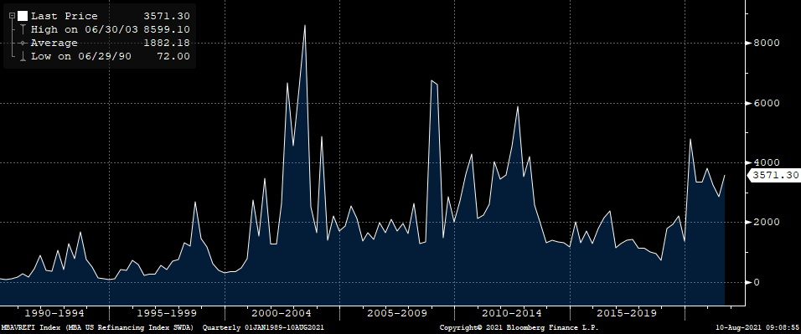
Exploratory Data Analysis Mortgage Refi Index
Dotcom Bubble
Housing Crisis
COVID-19 Pandemic

Slide 12
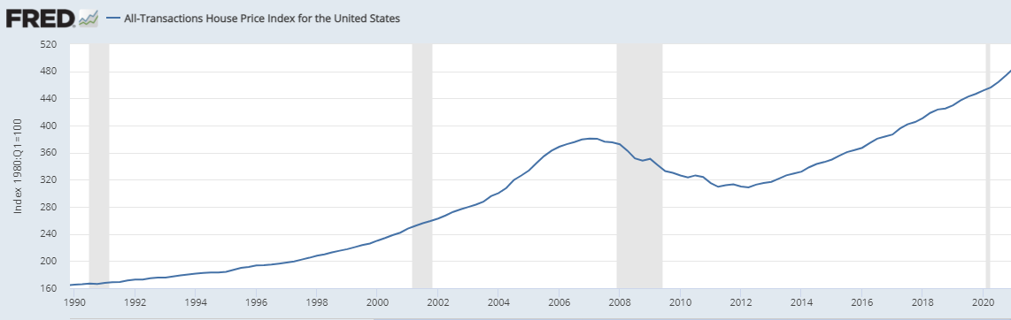
Exploratory Data Analysis National House Price Index
Housing Crisis

Slide 13

Model Selection
LSTM architecture
5- layered sequential NN model(with all features)
5- layered sequential NN model (with feature selection)
5- layered sequential NN model (with hyper parameter tuning)

Slide 14

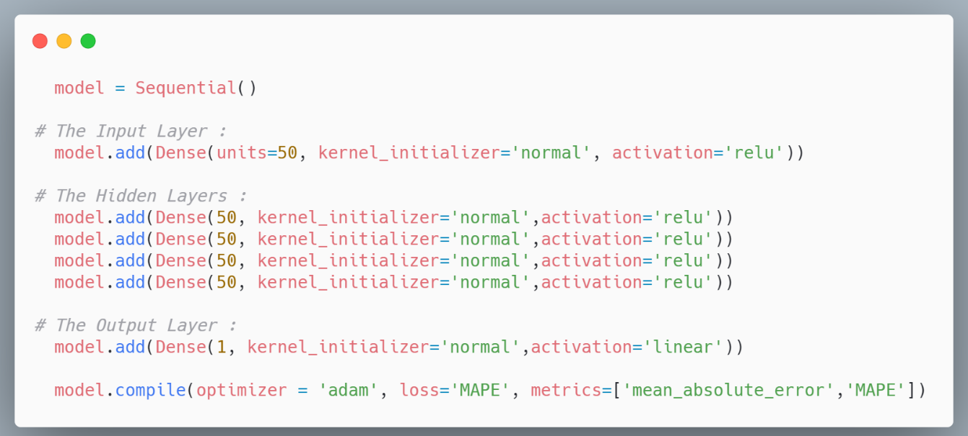
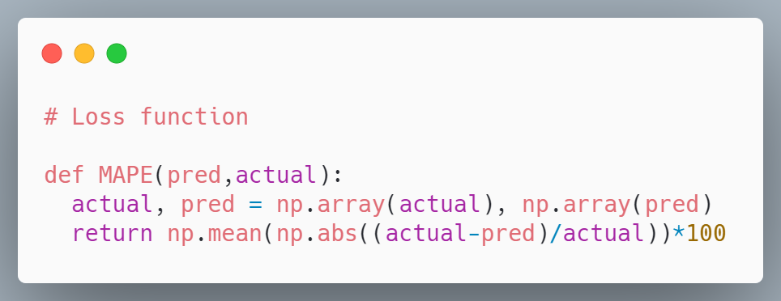
Neural Network Architecture
5 layers: 4 hidden and 1 output
Last layer has `linear` activation since we are predicting a continuous variable
Picking an arbitrary number of neurons, which is 50
Custom loss function is Mean Absolute Percentage Error (MAPE)
Optimizer `adam` was selected
Initial Model Performance:
MAPE = 13.69

Slide 15

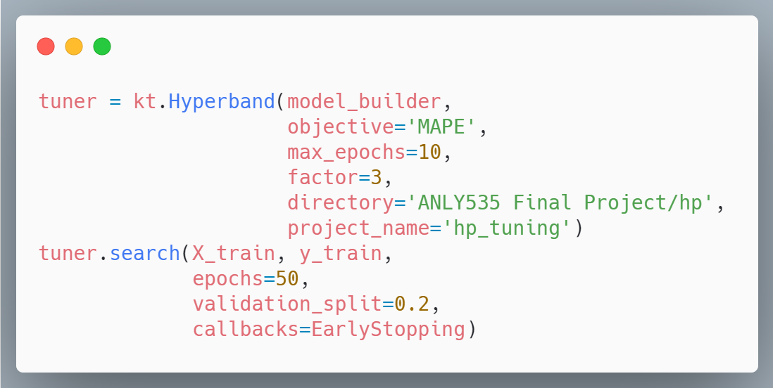
HyperParameter Tuning
Keras Tuner Library for hp tuning
Tuner used was `Hyperband`
“The Hyperband tuning algorithm uses adaptive resource allocation and early-stopping to quickly converge on a high-performing model.”
Optimum parameters found:
Learning rate = 0.001
Dense Neurons = 448

Slide 16

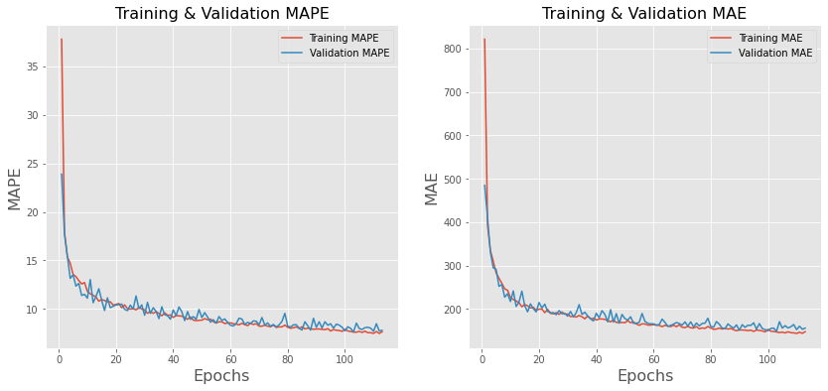
Training & Validation
MAPE of the optimized model reduced to 8.44

Slide 17

Model Results
Model | MSE | RMSE | MAE | MAPE | Varscore
5- layered sequential NN model(with all features) | 91096.52 | 301.82 | 174.11 | 11.07 | 0.94
5- layered sequential NN model (with feature selection) | 157647.36 | 434.24 | 231.35 | 13.68 | 0.92
5- layered sequential NN model (with hyper parameter tuning) | 40556.27 | 201.39 | 127.79 | 8.44 | 0.98

Slide 18

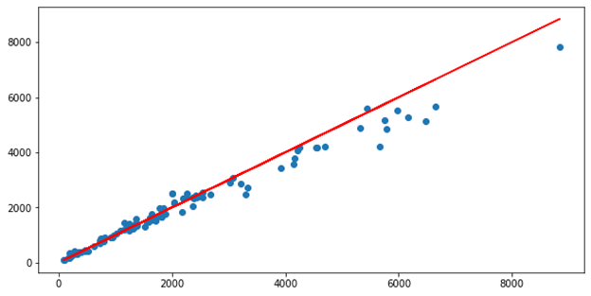
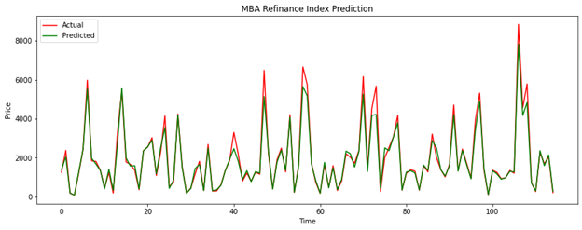
Model Test 1% of the dataset used as test
Notes:
1% dataset was used as test

Slide 19

Conclusion
LSTM model did not work well with our dataset
Best performing model was 5- layered sequential NN model (with hyper parameter tuning)
Best performing model had MAPE value of 8.44%. It is pretty good as you can see in the prediction graph.

Slide 20

Future Aspects
Our original plan was to use a single loan dataset from Freddie Mac which had around 45.5 million loans with 62 different fields.
We did not have computing power to run the data thus used MBS refinance index as a proxy.
We can add this dataset to the dataset used in this project and build a model with high computing power.

Slide 21
Thank you

